Slide 1
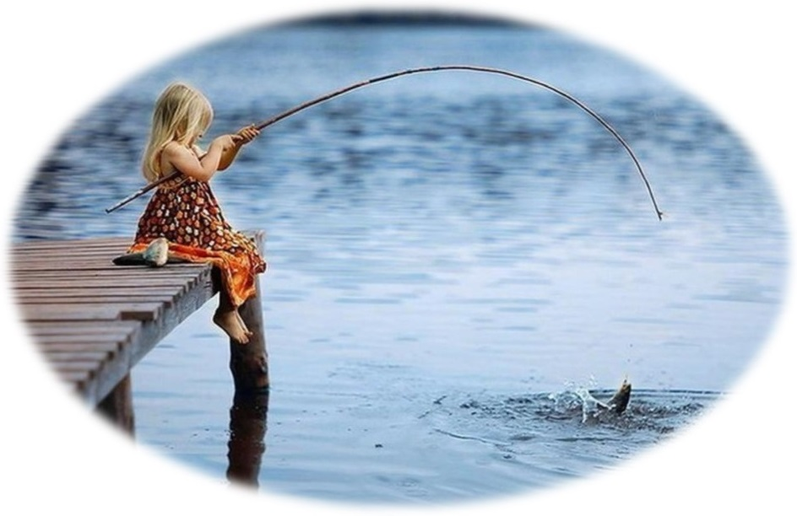
Ashley Creek
Share your concerns about water quality in Ashley Creek
and discuss how we can work together to improve it.
December 4, 2018

Slide 2
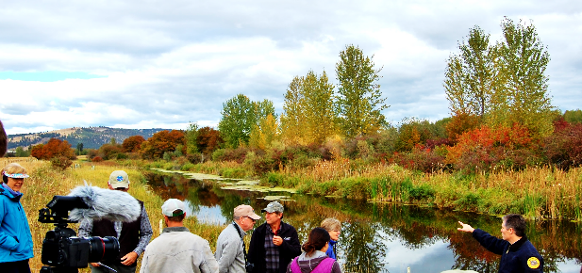
Ashley Creek Landowner meeting
Go around introductions. What you hope to get out of today.
Your water quality concerns, interests, projects, solutions.
Overview of Ashley Creek water quality problems study.
What can we do to make Ashley Creek healthier?
  What help would you need to improve Ashley Creek?
  How it fits in the bigger picture?
  People and programs that can provide financial and technical assistance.
Next steps
Notes:
SIGN and ASK people to add a pin on the map showing where their property is near Ashley Creek.
5 min - go around introductions
3 min - Who we are. Why we are here – brief intro.
10 min - Landowners stories: Dick Siderius, ask others to share

Slide 3
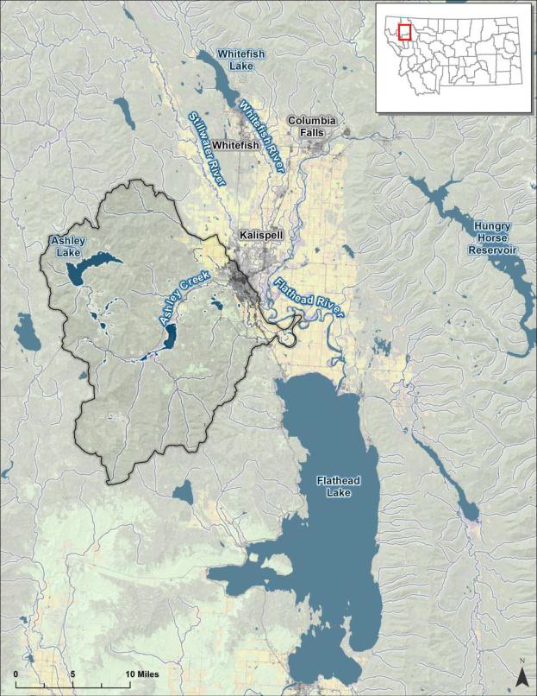
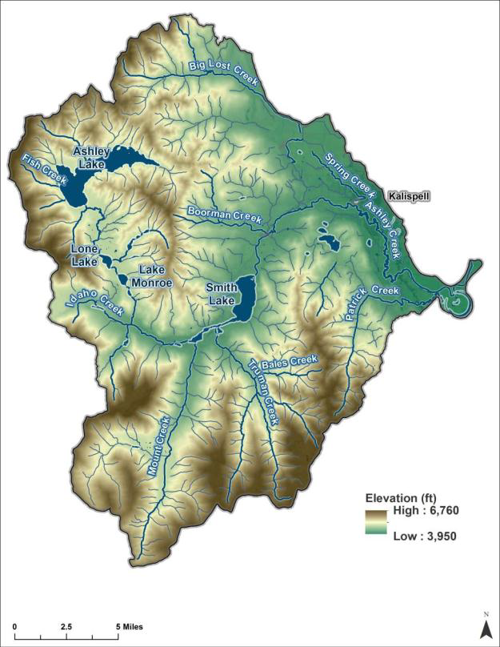
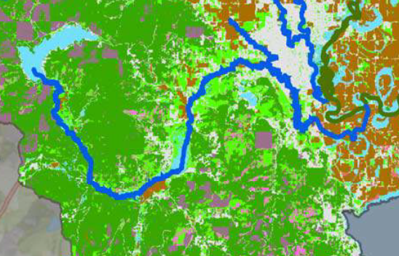
Ashley Creek
Watershed
Upper Ashley Cr.
Forested lands and
grazed agricultural meadows
Middle Ashley Cr.
Agricultural and residential
Lower Ashley Cr.
Agricultural and residential
324 square miles (207,360 acres)
177 miles of stream networks
Ashley Creek: 43.2 miles
Soils: 66% of area has highly erodible soils, and only 5% of the classified area is considered low-susceptibility to erosion.
Geology and water: Most wells are in bedrock (74% Belt rock in Salish Mountains) and shallow alluvium (12% in Flathead and Stillwater-Swan Wooded valleys) and are sensitive to surface contamination (bedrock cracks and fractures, and unconfined aquifers).
Notes:
Area- two-fifths as big as Anaconda or one-fifteenth as big as Glacier Bay National Park. (Flathead Lake is 191.5 sq miles).
Soils – 66% of area has highly erodible soils, and 77% has moderate to high erosion potential,
49.8% Alfisols (productive soils that can be susceptible to erosion if their surface litter is removed)
32% Inceptisols
11% Mollisols (agriculturally productive soils)
Geology:
74% Belt Series rocks
12% Alluvium
10% glacial
3% glacial lake deposits

Slide 4
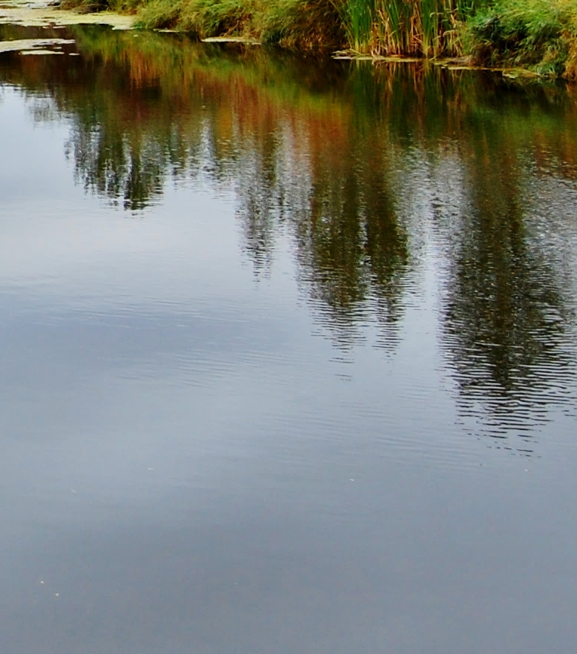
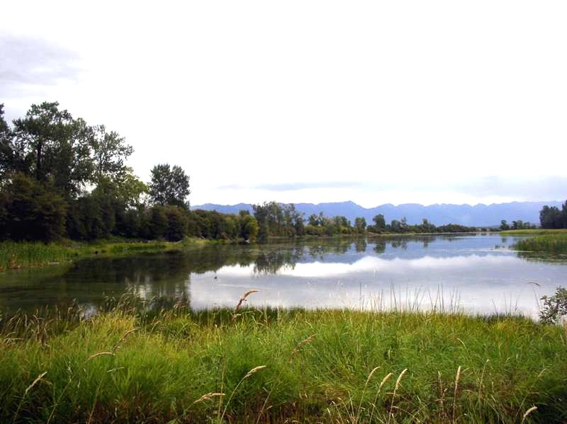
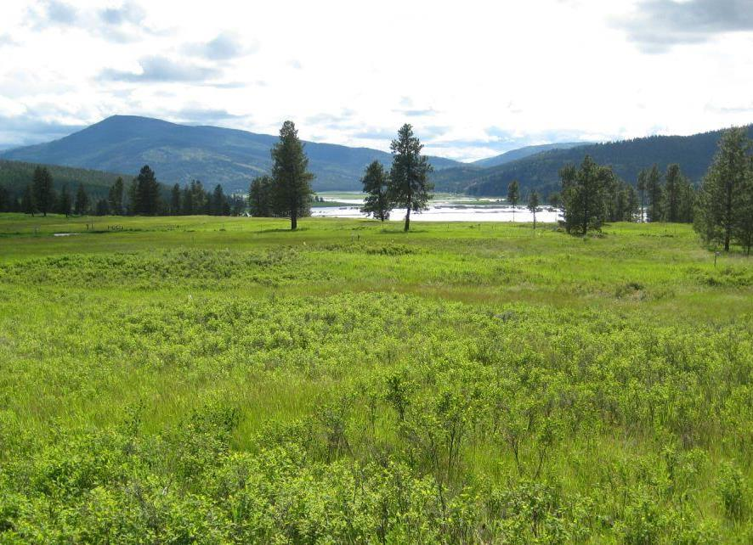
Notes:
We leave in this often picture perfect place. And this or something else is what we want to see.

Slide 5
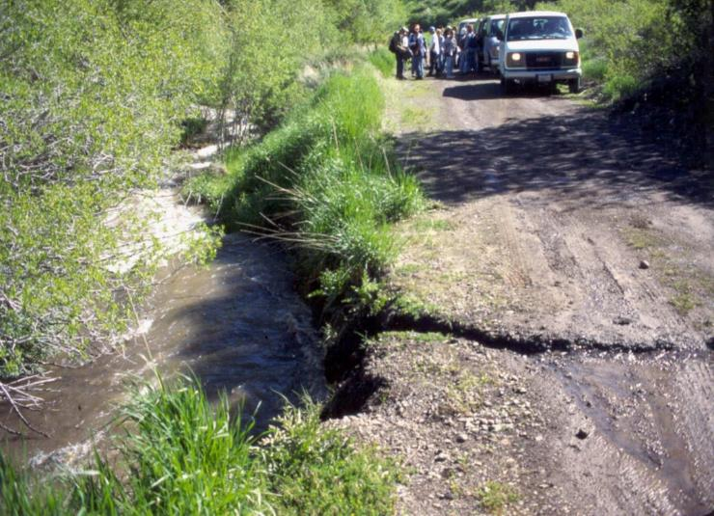
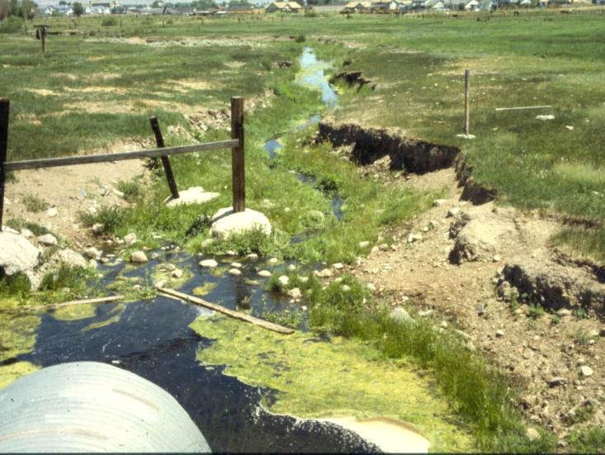
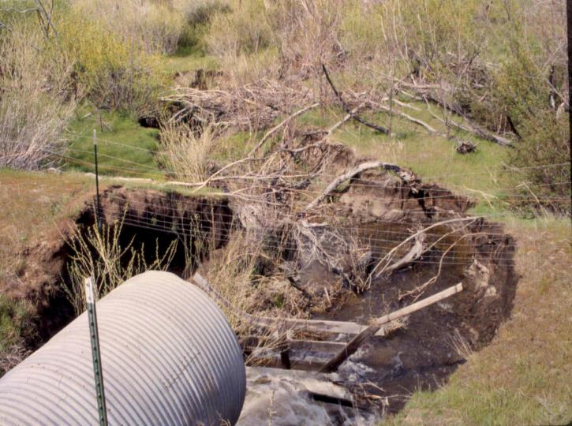
Notes:
But often, this is what we see instead. Ashley Creek is listed by MT Department of Environmental Quality (DEQ) as impaired for aquatic life, cold water fishery, and recreation due to water temperature, alteration in stream-side vegetation cover, nutrients, low flow alterations, excess algal growth, chlorophyll-a, and low dissolved oxygen.

Slide 6
Middle Ashley Creek
Upper
Ashley Creek
Lower
Ashley Creek

Slide 7
Map your concerns and solutions
Go around introductions, what you hope to get out of today.
Write your concern or potential solution/project (notecards) and share with audience (or hand to organizer).
Show on map where your concerns/problems and actions is located. Use color dot(s) to show:
  Concern or problem observed
  Examples:
  Loss of riparian habitat (historical, grazing, farming, urban development)
  Streambank erosion, downcutting, culvert problem
  Stream straightening / channelization
  Stormwater runoff (roads, lawns)
  Low water flows or creek dewatering
  Algae, nutrient inputs
  Point pollution source
  Invasive species, other…
  Desired action or potential project Other
  Examples:
  Stream banks restoration
  Riparian planting
  Livestock fencing or improved grazing management
  Culvert replacement or other fix
Notes:
Landowners concerns and interest. More in depth info. about problems
Landowners can share / write their concerns
Interactive mapping
Landowners can write concern or desired actions on sticker paper and pin on map
Discuss problems –
Presentation – overview
Tell landowners to think how their concerns/solutions fit into the larger picture. What might be missing from studies. Brainstorm solutions.

Slide 8
Water quality study findings
Water quality concerns | Upper Ashley Cr 15.64 mi | Middle Ashley Cr 14.17 mi | Lower Ashley Cr 13.17 mi
Sediment | √ | √ | √
Total Nitrogen | √ | √ | √
Total Phosphorous |  | √ | √
Temperature |  | √ | √
Low flow alterations |  | √
References:
2014 Tetra Tech, Ashley Creek Watershed Characterization, MT Dept. of Environmental Quality.
2014 MT Dept. of Environmental Quality, Flathead-Stillwater Planning Area Nutrient, Sediment, Temperature TMDL and Water Quality Improvement Plan.
2017 Flathead-Stillwater Watershed Restoration Plan, Flathead Conservation District.
2014 Flathead Lakers Flathead Lake Watershed Restoration Plan
Notes:
All of Ashley Creek, but especially from Smith Lake down/east (so, Middle and Lower Ashley Creek segments) need to reduce summer water temperatures.
All of Ashley Creek need lower sediment loads
All of Ashley Creek and Spring Creek (a tributary of Ashley Creek) all need lower total nitrogen loads to meet water quality targets.
Middle and Lower Ashley Creek segments and Spring Creek all need lower total phosphorus loads

Slide 9
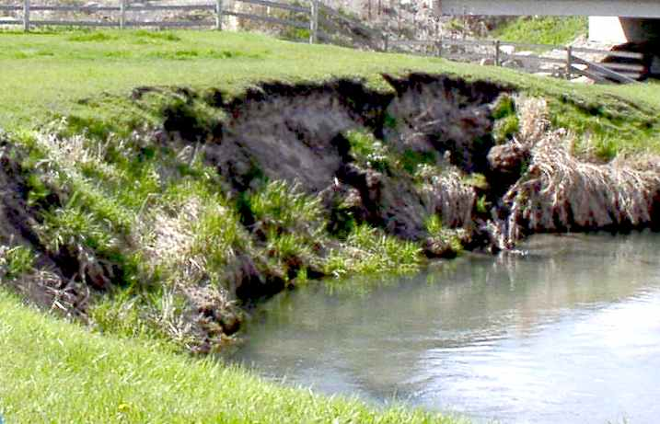

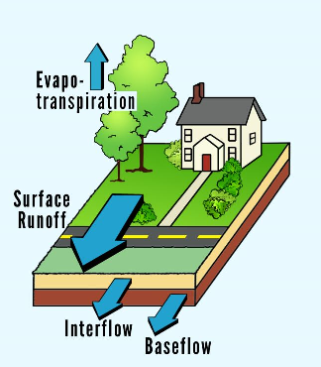
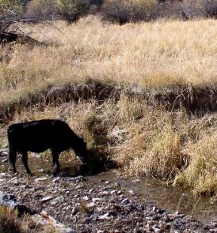
Sediment
Causes and sources:
  streambank erosion
  roads
  upland erosion
  urban areas
Notes:
Erosion and deposition of sediment are naturally occurring components of stable stream. However….
Excess sediment inputs into a creek can block sunlight, increase turbidity, and reduce rates of primary production.
Fine sediment can settle into creek’s substrate (e.g., pebbles or cobbles) and interfere with fish and macroinvertebrate survival and reproduction.
Excessive streambank erosion can result in channelization and exacerbate downcutting.

Slide 10
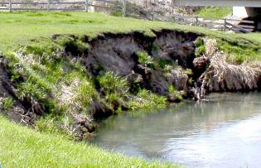

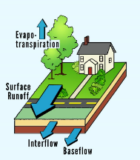
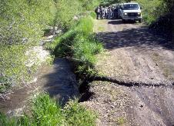
Sediment Sources | Upper Ashley Cr | Middle Ashley Cr | Lower Ashley Cr
Bank erosion | 51% | 54% | 53%
Agriculture | 4% | 9% | 10%
Unpaved roads | 4% | 2% | 2%
Urban areas | 1% | 7% | 14%
Timber harvest | 2% | 2% | 2%
Natural background | 38% | 26% | 19%

Slide 11
Sediment load reduction targets
Tons per year that need to be removed
 | Upper Ashley Cr | Middle Ashley Cr | Lower Ashley Cr | TOTAL (tons/year)
Streambank erosion | 140.4 (55%)* | 256.2 (48%) | 353.7 (48%) | 750.3
Upland erosion | 10.7 (5%) | 43.5 (11%) | 69.7 (14%) | 123.9
Unpaved roads | 5.3 (30%) | 5 (24%) | 7 (30%) | 17.3
*Percent reduction from the current estimated load is shown (e.i. Lower Ashley Creek, sediment loads are 736.8 tons/year and need to be reduced to 388 tons/year, which would be a 48% reduction).
**Ashley Cr. watershed has 409 miles of unpaved roads (including Spring Creek)- 92 of these miles are within 100 meters of perennial streams.

Slide 12
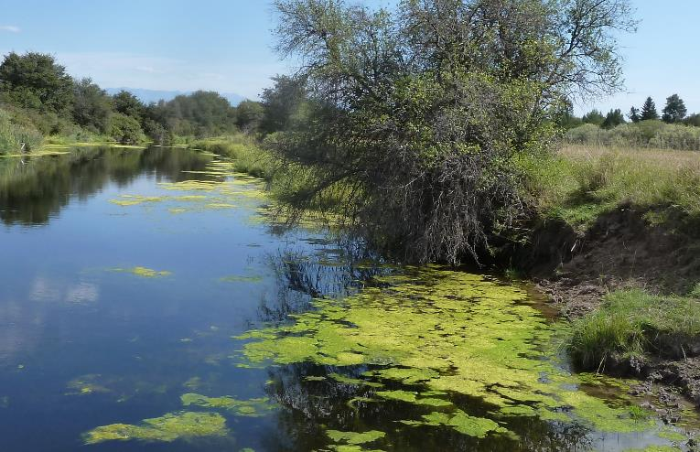

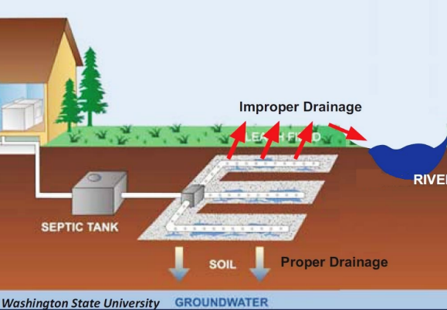
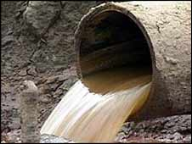
Nutrients
Causes and sources:
  septic systems
  agriculture
  urban areas
  point sources
  atmospheric deposition
Notes:
Nutrients increase algal growth and lower dissolved oxygen – creates toxic conditions to humans, livestock, aquatic life, wildlife.

Slide 13
Nutrient sources | Upper Ashley Cr | Middle Ashley Cr | Lower Ashley Cr | Spring Creek 4.8 mi
Septic systems | 6% | 17% | 15% | 50%
Agriculture |  | 4% | 4% | 26%
Atmospheric deposition | 13% | 11% | 7%
Urban and suburban areas |  | (Total Phosphorus) | 4% | 23%
Point sources |  | (Total Phosphorus) | 30%
Unknown (may be natural) | 71% | 58% | 35%
Natural background | 8% | 8% | 5%

Slide 14
Nutrient load reduction targets
Pounds per day that need to be removed
 | Upper Ashley Cr | Middle Ashley Cr | Lower Ashley Cr | Spring Creek 4.8 mi | TOTAL (lb/day)
Total Nitrogen (TN) reductions (lb/day) | 4.73 (28%) | 45.49 (67%) | 210.4 (91%) | 7.8 (53%) | 268.42
Total Phosphorus (TP) reductions |  | 0.41 (17%) | 2.57 (58%) | 1.34 (68%) | 4.32
Ashley Creek watershed has 3,353 septic systems - 182 of these are within 100 feet from Ashley & Spring creeks.
Notes:
Potential sources: septic systems, stormwater runoff, agricultural fertilizers, unpaved roads, wind, rain
(found not to contribute: forest fires, timber harvest)
3,353 septic systems - 182 are within 100 feet from Ashley & Spring creeks
409 miles of unpaved roads - 92 of those miles are within 330 feet of perennial streams.

Slide 15

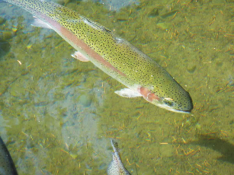

Warm water temperatures due to lack of shade
Warmer water affects native fish reproduction and survival, and limits dissolved oxygen.
Temperature | Upper Ashley Cr | Middle Ashley Cr | Lower Ashley Cr
Current temperature | 66.2° F | 73.1° F | 68.61° F
Target temperature | 65.5° F | 67.6° F | 62.01° F
Temperature reductions | 0.7° F 2% reduction | 5.5° F 13% | 6.6° F 15%
Stressed fish, especially trout, often don’t survive in warm water.
Photo: Pixabay

Slide 16
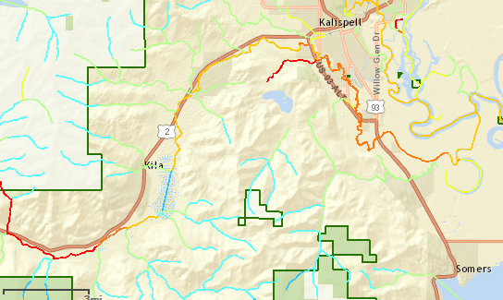

NorWeST Stream Temperature Map, USFS RMRS
1993-2011 Observed Temperatures
Temperature (F)
< 46.4
46.4 - 50
50 - 53.6
53.6 - 57.2
57.2 - 60.8
60.8 - 64.4
64.4 - 68
> 68

Slide 17
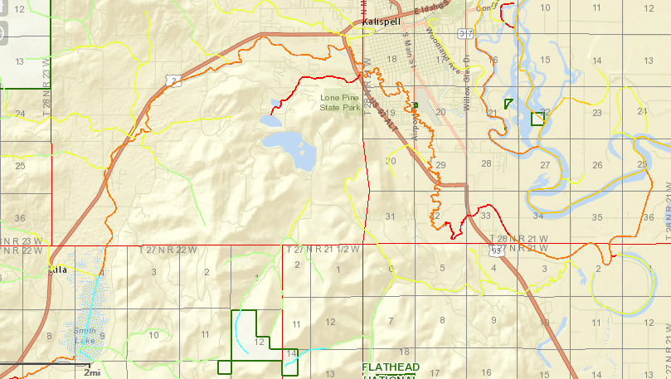
NorWeST Stream Temperature Map, USFS RMRS
2040 Modeled Temperatures
Temperature (F)
< 46.4
46.4 - 50
50 - 53.6
53.6 - 57.2
57.2 - 60.8
60.8 - 64.4
64.4 - 68
> 68

Slide 18
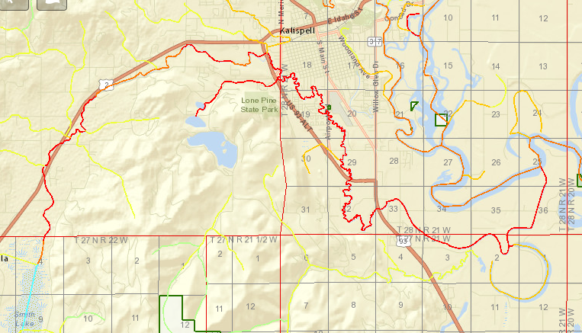
NorWeST Stream Temperature Map, USFS RMRS
2080 Modeled Temperatures
Temperature (F)
< 46.4
46.4 - 50
50 - 53.6
53.6 - 57.2
57.2 - 60.8
60.8 - 64.4
64.4 - 68
> 68

Slide 19
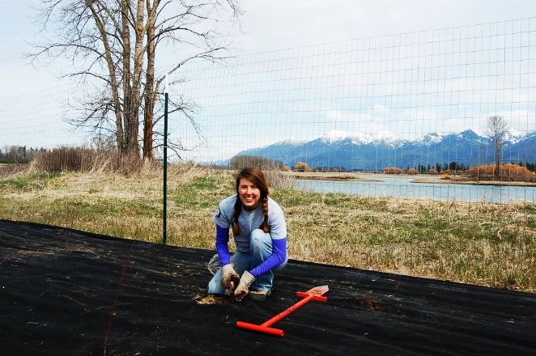
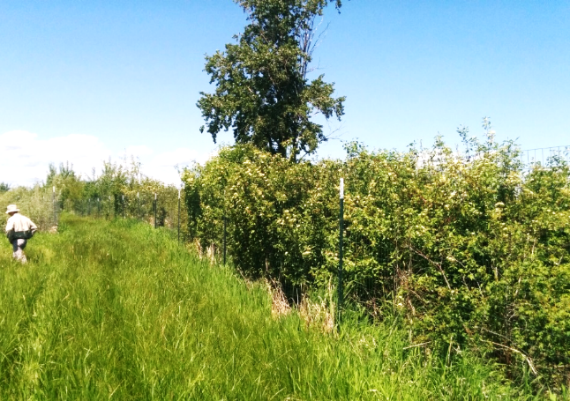
Solutions
BEFORE
Improve riparian and wetland vegetation to reduce increase streambank stability, shade, and reduce pollutant delivery from upland sources
  Increase shade targets: Upper AC 24% , Middle AC 78%, Lower AC 87%
  temperature, sediments, nutrients
Fence livestock away from stream or implement rotational grazing management plan.
  sediments, nutrients
AFTER

Slide 20
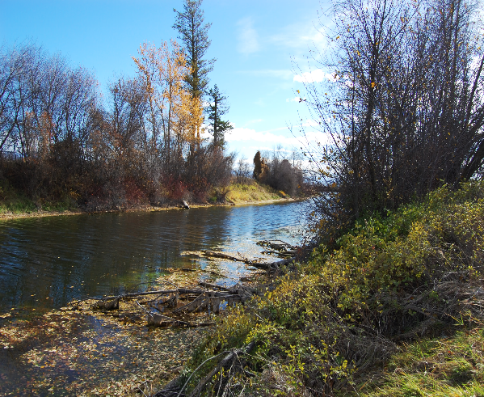
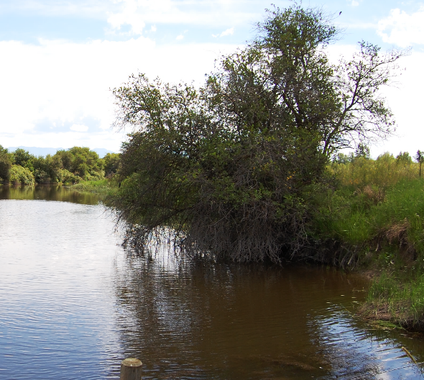

Solutions
Improve instream discharge conditions during the hottest summer months:
  Increase target: 15% in Middle Ashley Creek
  Temperature, water flows
Maintain stream channel widths
  Upper AC: 16 – 25 ft.; Middle AC: 24 – 42 ft. , Lower AC: 26 – 94 ft.
  Temperature, erosion
Protect wetlands, floodplain, riparian areas
  Temperature, sediments, nutrients

Slide 21
Solutions
Inspect and maintain septic systems and replace old ones (15-30 years old).
  Nutrients
Build in upland areas and other suburban BMPs
  Nutrients, sediments
Flathead Watershed Restoration Plan Recommendations
(p. 88-92 Best Management Practices for agriculture, suburban, forestry, stream restoration & transportation; and p.59, Spring Cr.)

Slide 22
Solutions
Flathead Watershed Restoration Plan Recommendations (p.48)
Urban Best Management Practices (BMPs)
Control/reduce stormwater runoff
Roads and culverts BMPs
Install and properly maintain culverts.
Minimizing the number of roads constructed in the watershed.
See Watershed Restoration Plan for more…
Timber harvesting BMPs
Use logging systems that best fit the topography, soil type, and season, and minimize soil disturbance.
Avoid harvesting near stream banks.
Notes:
MORE BMPs in WRP…..Maintain erosion control features including cleaning dips and cross drains, repairing ditches, marking culvert inlets, and clearing debris from culverts.
Build in upland areas.
Fit road to topography and avoid long, step road grades and narrow canyons.
Design roads to minimize disruption of natural drainage patterns.
Abandoned roads should provide adequate drainage without further maintenance. Actions may include: reseeding and/or scarification, re‐contouring, and installing water bars or drain dips.

Slide 23
Ashley Creek Landowner meeting
What can we do to make Ashley Creek healthier?
  People and programs that can provide financial and technical assistance.
  What help would you need to improve Ashley Creek
  Brainstorm solutions and next steps: how do concerns/solutions fit or are missing in the larger picture.
Next steps
  Talk to program staff about how they can help you.
  Sign up for cost-share program(s).
  Sign up for site visit to your property or a location of interest.
  Recommend others who should be in this conversation.
  Assess concerns, interests, needs and follow up with individuals and other landowner to seek solution.
Notes:
Discuss how concerns/solutions brought up by landowners fit into the larger picture, or are missing from studies.
Brainstorm solutions and next steps.
Time for landowners to talk to program representatives; sign up for assistance or site visit.
Landowners: recommend neighbors, other landowners to contact. NEW CONTACTS SHEET.
Partners: collect more input from others if needed; assess problem and get back to participants; arrange for site visits to assess potential projects or assist with for project planning and implementation. Emphasize LONG TERM.

Slide 24
Landowner Assistance Programs
Flathead Conservation District Cost-Share program
Flathead Conservation District Seedling Program
Ranching for Rivers Cost-Share program
Department of Environmental Quality 319 grants
USDA Natural Resource Conservation Service Conservation Programs
Flathead River Steward Program
Montana Fish, Wildlife and Parks Future Fisheries Improvement Program

Slide 25
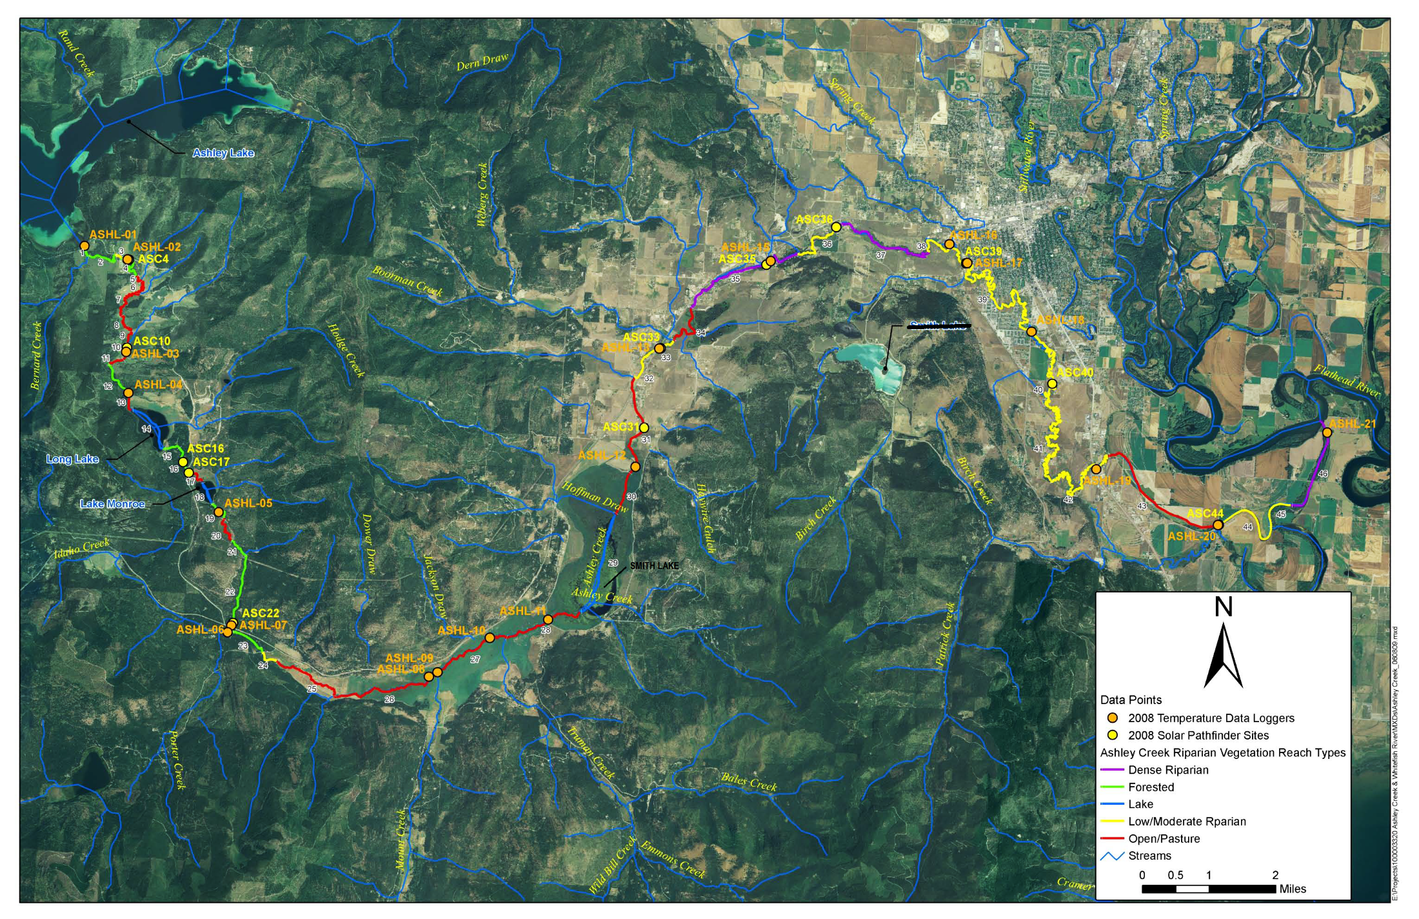
Notes:
Review map and pins. Discuss problems and projects proposed and next steps.
Someone take notes…

Slide 26
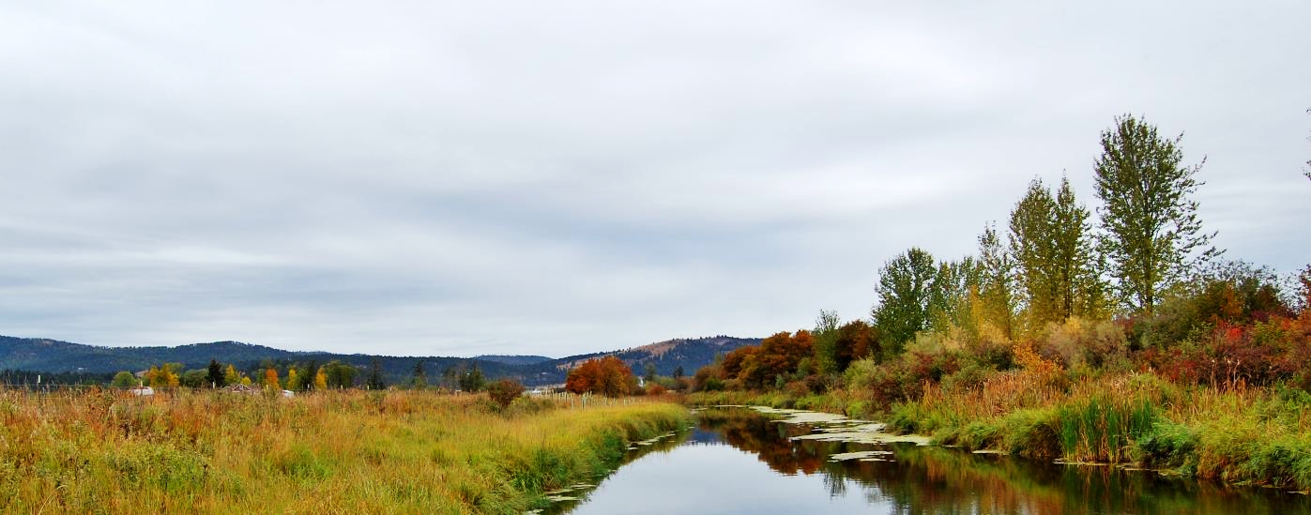
Ashley Creek Landowners
Thank you for joining your neighbors to find solutions for
Ashley Creek.

Slide 28
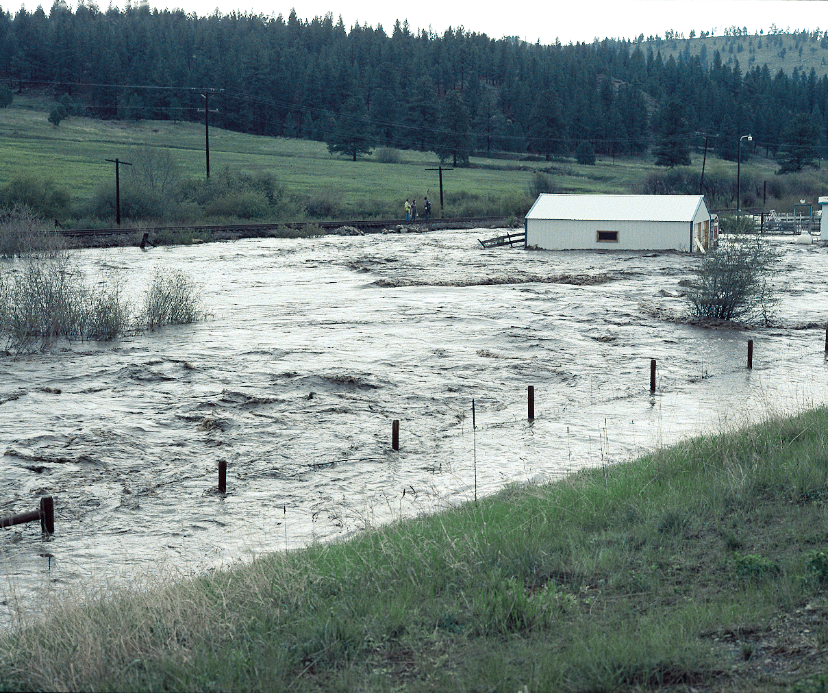
Montana
UNCE, Reno, NV
Notes:
Instructor: Use this slide to highlight risks associated with floods and property damage, health and safety risks, aggravation, damage to streams that occurs during floods, cost of flood management, etc.

Slide 29
http://waterdata.usgs.gov/nwis/
Notes:
Monthly mean streamflows for Ashley Creek near Kalispell, MT

